Slide 1

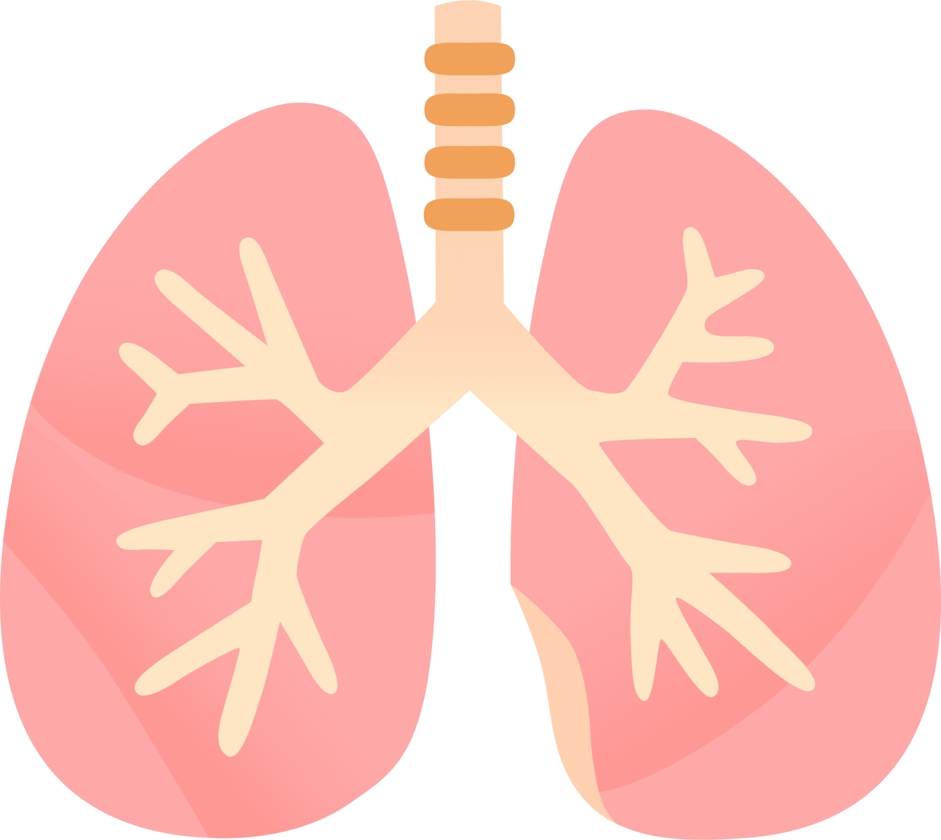
LUNG SOUND RECORDER
Team: Quad-Core Squad
By: Karthik, Aryanil, Anurag, and Adithya
Professor: Abhishek
TA: Srikar, Santhoshini
Week-2

Slide 2
Targets achieved…
Aryanil
This week, I was focusing on code and comparisons of melodic spectrograms of different methods and plot them to see the visual difference.
I also inferred findings from the graphs to use them to make the master algorithm.

Slide 3
About the code…
Aryanil
Code can be found via Github: https://github.com/AryanilPanja/lung_sound_recorder/tree/main/melspec_compare
The code basically uses the library librosa, pyplot and numpy to make up the comparison diagrams

Slide 4
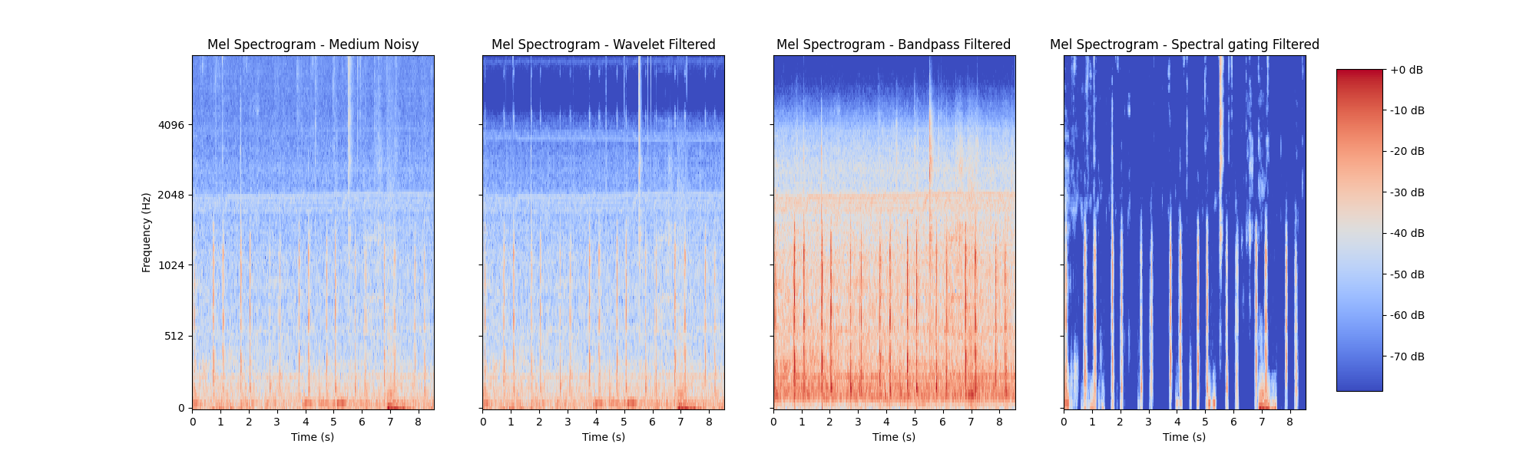
Difference in Low noise
Aryanil

Slide 5
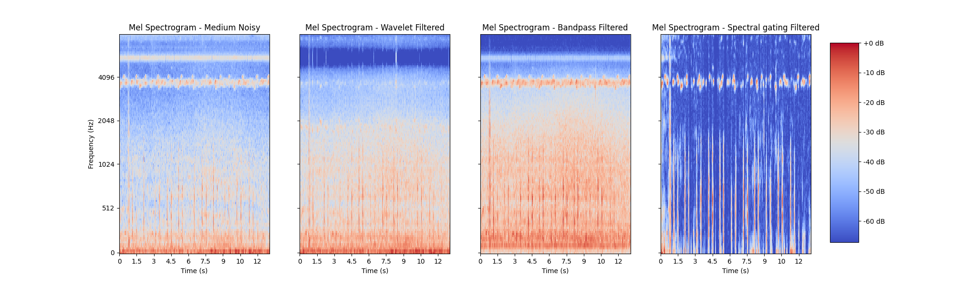
Difference in Medium noise
Aryanil

Slide 6
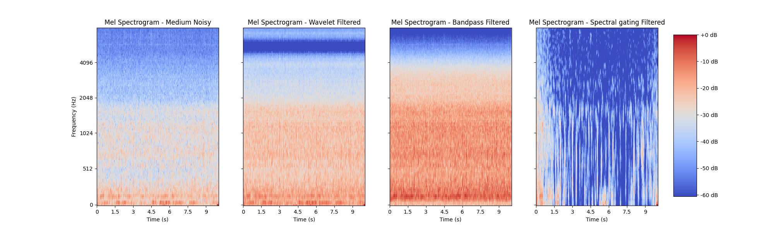
Difference in Loud noise
Aryanil

Slide 7
What do we infer from the graphs….
Aryanil
From the mel-spectrogram we could clearly identify that spectral gating cleans the noise from the same frequency level of heartbeat, thus being extremely efficient.
It is seen that wavelet-transform does aggressive removal from the higher frequencies.
It is also seen that bandpass-filter fails to remove the higher frequencies but boosts the lower frequencies.
We also noticed that in loud surroundings, due to multiple sounds of same frequency and due to irregularity, the surrounding noise drowns the heart-beat sound and its difficult to clean that up.

Slide 8
What Did I Do?
Karthik
This week, I had focused on software, and getting the mic to record sound.
I had learned the pin diagram of microphones sensor.
I understood the type of data and information it collects.
I learned the workings of I2S protocol, and its uses in the field of audio recording.

Slide 9
Did We Write Code?
Karthik
We tested the sensor with the code that will record the sound, and print the values recorded in an array.
When we plot the data, we get the representation of sound. We plan to send this data to python for further processing.
Code can be found via Github: https://github.com/AryanilPanja/lung_sound_recorder/blob/main/ESP_codes/Esw_test1.ino

Slide 10
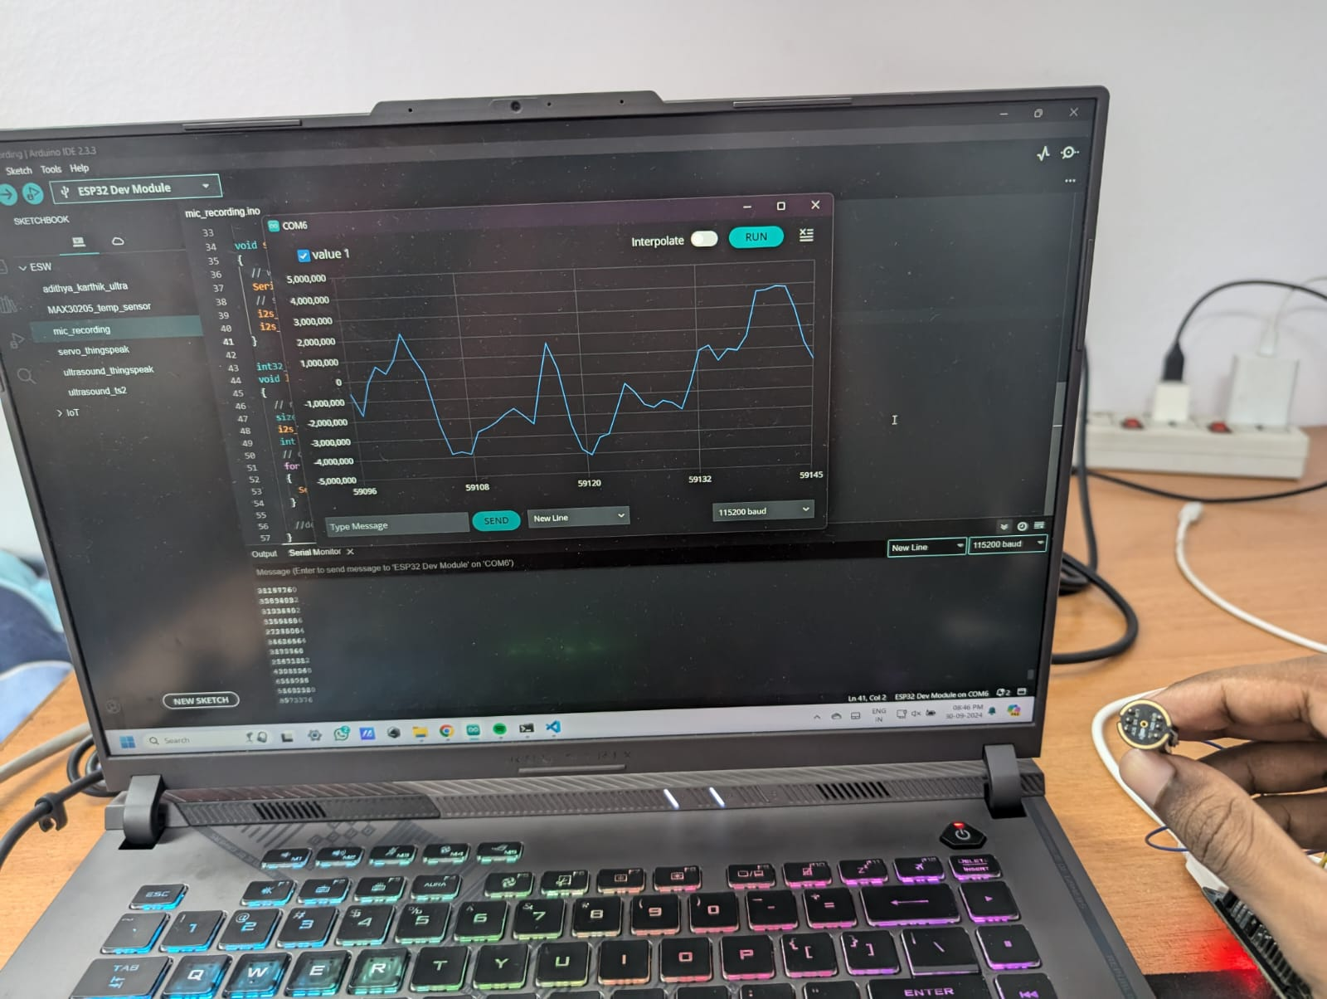
Output of Mic Sensor
We noticed the plot increasing and decreasing in correspondence with the amplitude of voice input.

Slide 11
Did I Use Resources?
Karthik
Yes!
https://hubtronics.in/inmp441-omnidirectional-microphone-module (to learn pin diagram)
https://www.studocu.com/my/document/universiti-malaya/digital-electronics/inmp441/93726716
https://www.keysight.com/blogs/en/tech/bench/2022/04/29/the-i2s-protocol-and-why-digital-audio-is-everywhere (to learn about I2S protocol)

Slide 12
Body temp sensor
Wrote code for the MAX30205 body temp sensor
Got body temperature values in Celsius
Temperature changes slowly over time
We will use the temperature in addition to the sound during classification
Anurag

Slide 13
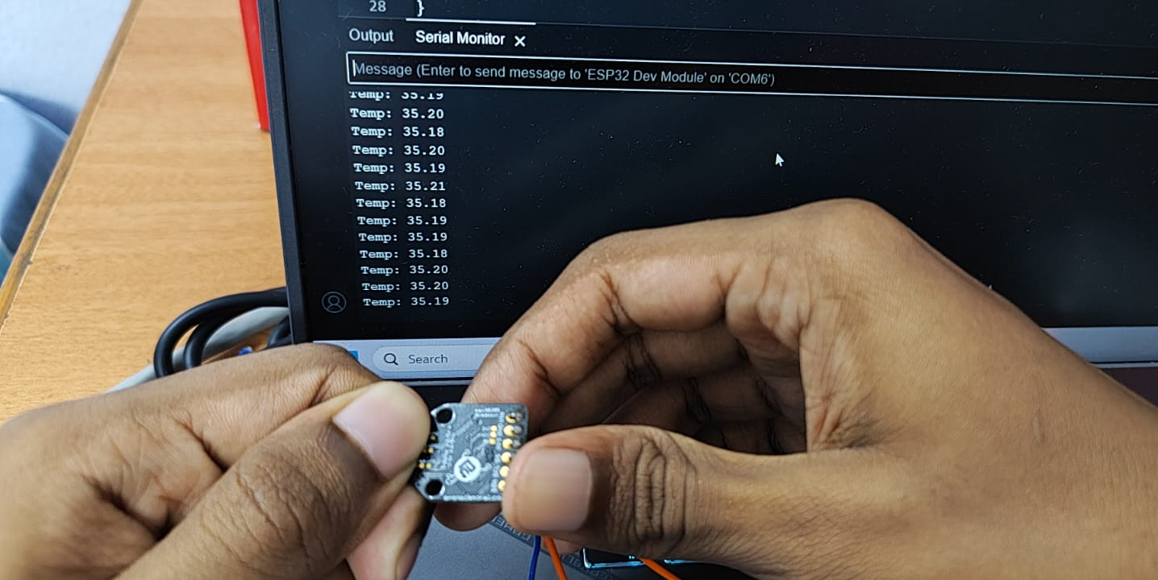

Slide 14
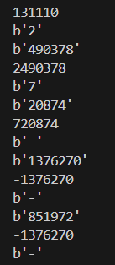
Esp to python
Used serial and time libraries in python to pass data from ESP32 to python file
Sent output of INMP441 mic to python for further processing
The sound will then be processed using noise filtering techniques to get the final output
Anurag

Slide 15
Code
For the MAX30205 sensor:
https://github.com/AryanilPanja/lung_sound_recorder/blob/main/ESP_codes/MAX30205_temp_sensor.ino
For ESP to python:
https://github.com/AryanilPanja/lung_sound_recorder/blob/main/serial_test.py
Anurag

Slide 16
References
https://stackoverflow.com/questions/66502267/problem-reading-data-from-esp32-to-python
https://pyserial.readthedocs.io/en/latest/shortintro.html#readline
https://www.arduino.cc/reference/en/libraries/closedcube-max30205/
https://www.analog.com/en/products/max30205.html#part-details
Anurag

Slide 17
The best possible combination
Earlier, we had come up with 3 ways to filter the wav file(band pass filter, spectral gating, wavelet transformation).
To obtain the most optimal filtering algorithm, we tried all possible combinations of the 3 algorithms(leaving algorithms out of the filtering one by one) having band pass filter as the first stage of filtering.
Adithya

Slide 18
The best possible combination
The band pass filter is applied first because by concentrating on the frequency band of interest, it ensures that only meaningful lung sound components are processed further
After trying out all the possibilities, we found that using all three filtering algorithms gave the best results.
Even the first research paper mentioned in the "References" page followed a similar flow, by applying bandpass filter followed by wavelet denoising after which an adaptive filter was used (in our case spectral gating is the adaptive filter).
Adithya

Slide 19
The final filtering code
After merging all the filtering algorithms, we observed that while the noise had significantly been filtered out, the sound of the heartbeat was very faint.
To fix this we amplified the filtered output by a factor of 10.
Adithya

Slide 20
Code
After merging the 3 filtering algorithms and amplifying the signal by a factor of 10(we do not want to multiply the amplitude by a very large factor as it risks clipping of the heart sound, leading to distortion), the code we obtained is given below
https://github.com/AryanilPanja/lung_sound_recorder/blob/main/filtered_algo/all3.py Adithya

Slide 21
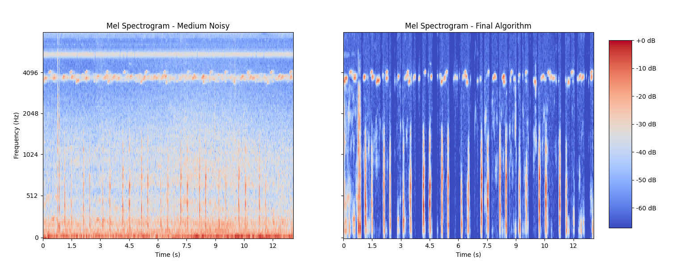
Original audio vs final audio
Aryanil & Adithya

Slide 22
References
https://www.ncbi.nlm.nih.gov/pmc/articles/PMC6743292/
https://stackoverflow.com/questions/13329617/change-the-volume-of-a-wav-file-in-python
https://numpy.org/doc/stable/reference/generated/numpy.clip.html
Adithya

Slide 23
Sound
Mic
ESP to python
Bandpass filter
Spectral Gating
Onto classification
Anurag

Slide 24
Next Week
Get readings of both mic and temp sensor at once
Streamline process of removing noise
Finish up with noise reduction processing
Maybe start working on CNN or SVM for classification

Slide 25
Thank you! 😊

